Slide 1
Cloud Computing
Guide
&
Handbook
SAI USA
Madhav Panwar

Slide 2
Background
2010 WGITA approved the cloud computing project with SAI USA as lead and Canada & India as members
2011 A status report was presented and comments solicited
2012 Final project description and common cloud computing risks were presented
Members requested that this work be augmented with a cloud computing guide and audit handbook
Guide & handbook completed for CC.
2013 Will be incorporated into the overall IT Audit Guide & Handbook in cooperation with IDI

Slide 3
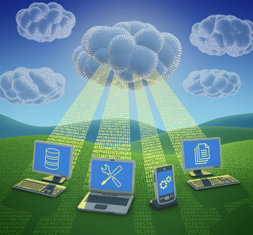
What Is Cloud Computing?
Generally speaking, cloud computing can be thought of as anything that involves delivering hosted services over the Internet.
According to NIST Cloud computing is a model for enabling ubiquitous, convenient, on-demand network access to a shared pool of configurable computing resources (e.g., networks, servers, storage, applications, and services) that can be rapidly provisioned and released with minimal management effort or service provider interaction. (Special Publication 800-145)

Slide 4
What It Provides
Cloud computing provides shared services as opposed to local servers or storage resources
Enables access to information from most web-enabled hardware
Allows for cost savings – reduced facility, hardware/software investments, support

Slide 5
Essential Characteristics
On-demand self-service
  A consumer can unilaterally provision computing capabilities, such as server time and network storage, as needed automatically without requiring human interaction with each service provider.
Broad network access
  Capabilities are available over the network and accessed through standard mechanisms that promote use by heterogeneous thin or thick client platforms (e.g., mobile phones, tablets, laptops, and workstations).
  Source: NIST Special Publication 800-145

Slide 6
Characteristics
Resource pooling
  The provider’s computing resources are pooled to serve multiple consumers
  Resources can be dynamically assigned and reassigned according to customer demand
  Customer generally may not care where the resources are physically located but should be aware of risks if they are located offshore
  Source: NIST Special Publication 800-145

Slide 7
Characteristics
Rapid elasticity
Capabilities can be expanded or released automatically (i.e., more cpu power, or ability to handle additional users)
To the customer this appears seamless, limitless, and responsive to their changing requirements
Measured service
  Customers are charged for the services they use and the amounts
  There is a metering concept where customer resource usage can be monitored, controlled, and reported, providing transparency for both the provider and consumer of the utilized service
  Source: NIST Special Publication 800-145

Slide 8
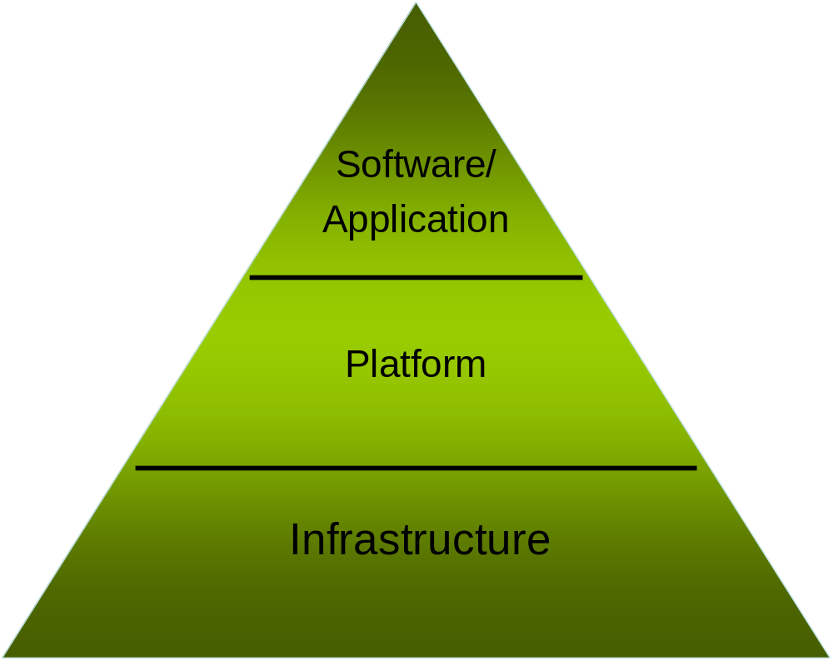
Service Models

Slide 9
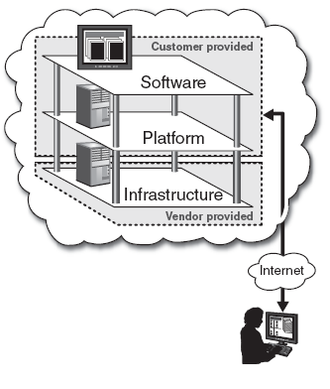
Service Models
Infrastructure-as-a-Service (IaaS)
A service model that involves outsourcing the basic infrastructure used to support operations--including storage, hardware, servers, and networking components.
The service provider owns the infrastructure equipment and is responsible for housing, running, and maintaining it. The customer typically pays on a per-use basis.
The customer uses their own platform (Windows, Unix), and applications

Slide 10
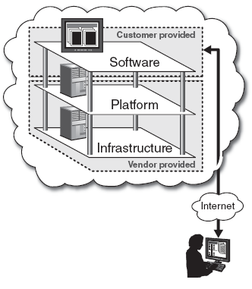
Service Models
Platform-as-a-Service (PaaS)
A service model that involves outsourcing the basic infrastructure and platform (Windows, Unix)
PaaS facilitates deploying applications without the cost and complexity of buying and managing the underlying hardware and software where the applications are hosted.
The customer uses their own applications

Slide 11
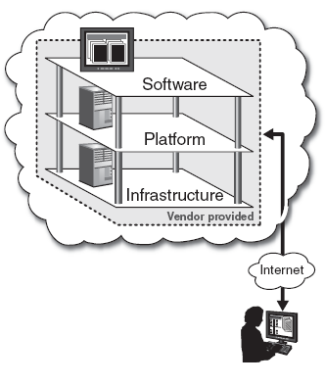
Service Models
Software-as-a-Service (SaaS)
Also referred to as “software on demand,” this service model involves outsourcing the infrastructure, platform, and software/applications.
Typically, these services are available to the customer for a fee, pay-as-you-go, or a no charge model.
The customer accesses the applications over the internet.

Slide 12

Where Is My Data?
Data resides on servers that the customer cannot physically access
Vendors may store data anywhere at lowest cost if not restrained by agreement

Slide 13
Cloud Computing Guide
The guide is about a 10 page document that describes cloud computing and areas of risk
These risks should be managed by the IT organization that chooses to utilize cloud computing
For IT Auditors these risks are a roadmap which you can utilize to create your audit program

Slide 14
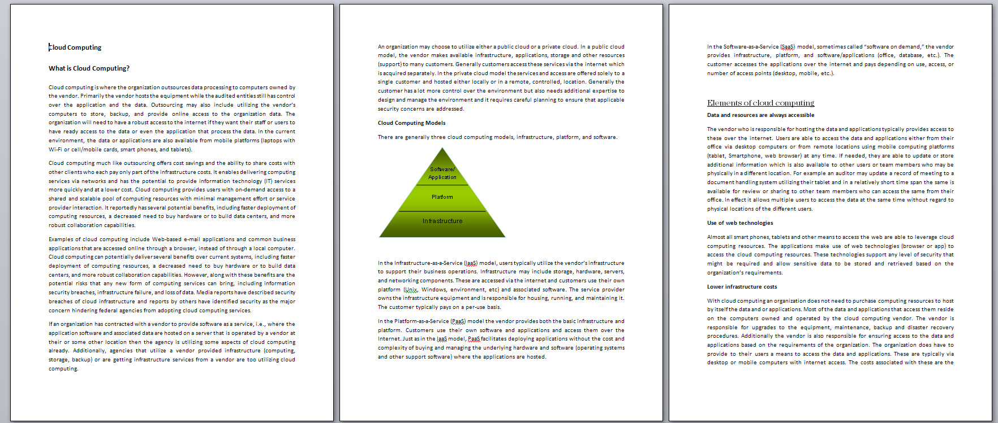
Cloud Computing Guide

Slide 15
Cloud Computing Guide
What is Cloud Computing?
Cloud computing is where the organization outsources data processing to computers owned by the vendor. Primarily the vendor hosts the equipment while the audited entities still has control over the application and the data. Outsourcing may also include utilizing the vendor’s computers to store, backup, and provide online access to the organization data. The organization will need to have a robust access to the internet if they want their staff or users to have ready access to the data or even the application that process the data. In the current environment, the data or applications are also available from mobile platforms (laptops with Wi-Fi or cell/mobile cards, smart phones, and tablets).

Slide 16
Cloud Computing Guide
Audit Concerns
When an organization chooses to utilize cloud computing, they need to be aware of risks that they may face with the service provider, the risk they face if they are unable to effectively oversee the service provider, and other risks related to management and security weaknesses in the service providers approach. As an auditor you will need to understand what the agency has done to mitigate the risks with cloud computing. When we as auditors are asked to appraise whether an entity or organization getting the benefits of cloud computing are managing the vendor to ensure that they get the required services we need to be aware of the risks that they may face.

Slide 17
Cloud Computing Guide
Risk Areas
  Service Provider Risks
  Technical Risks
  External (Overseas) Risks
  Management/Oversight Risks
  Security / Connectivity / Privacy Risks
  These were discussed at the last meeting along with some mitigation
  strategies that the IT organization could use
  The IT auditor would use those as a road map to frame audit questions

Slide 18
Cloud Computing Handbook
The handbook provides the IT Auditor with some audit related questions that begin to explore whether the organization is managing the risks and the vendor

Slide 19
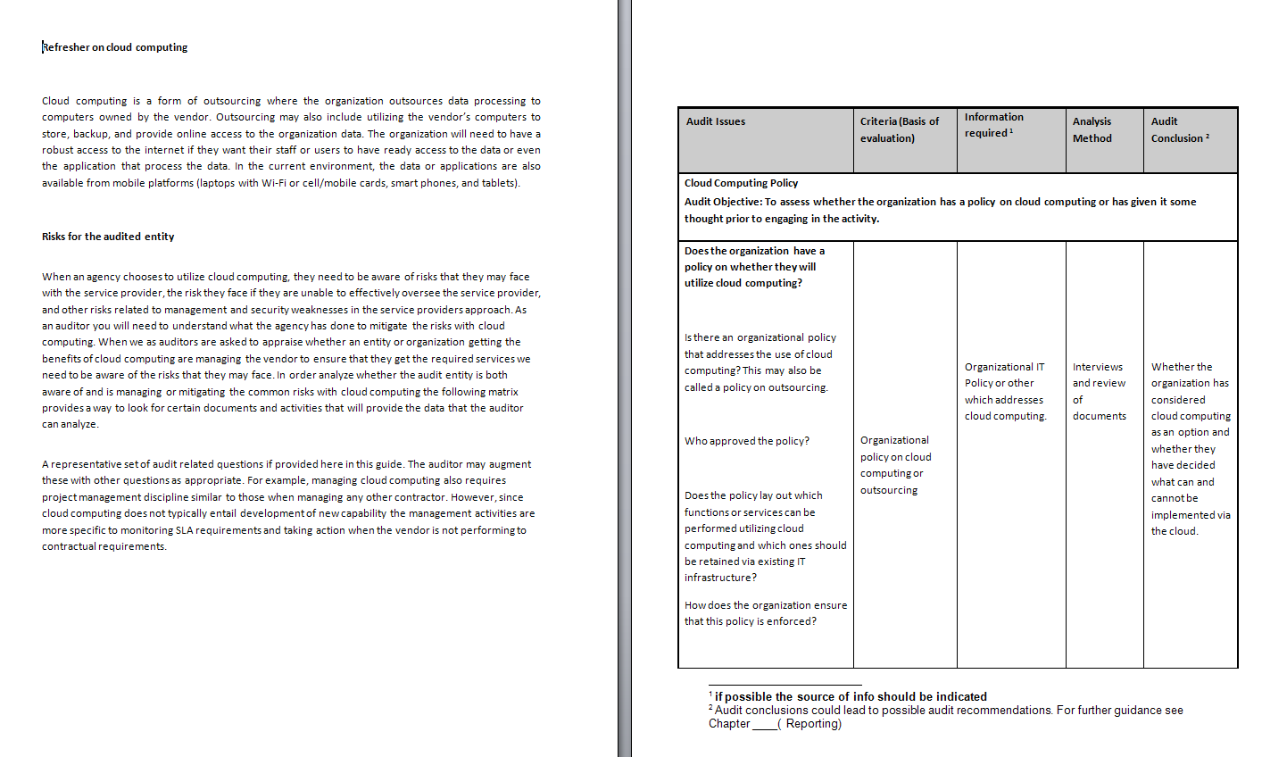
Cloud Computing Handbook

Slide 20
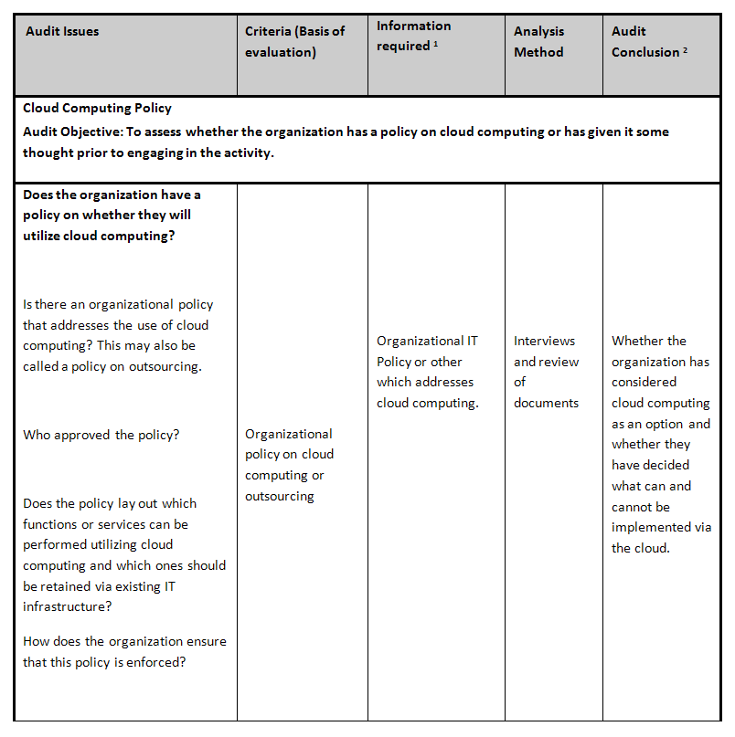
Cloud Computing Handbook

Slide 21
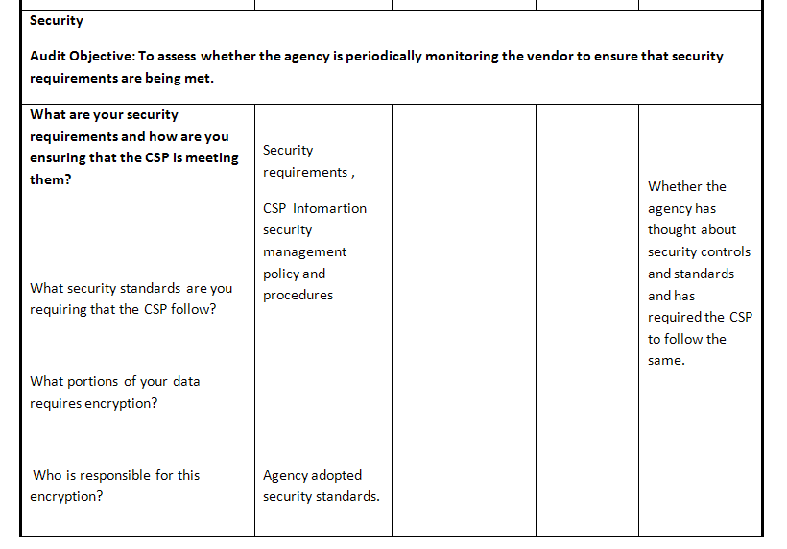
Cloud Computing Handbook

Slide 22
Next Steps
As and when members conduct IT Audits that involve Cloud Computing we would like to receive your audit questions so we may update the guide
Members may contact the Chair or SAI USA for additional information

Slide 23
Contacts
SAI India
Jagbans Singh
ir@cag.gov.in
SAI USA
Madhav Panwar
panwarm@gao.gov

